Slide 1
Using Apache IVY

Slide 2
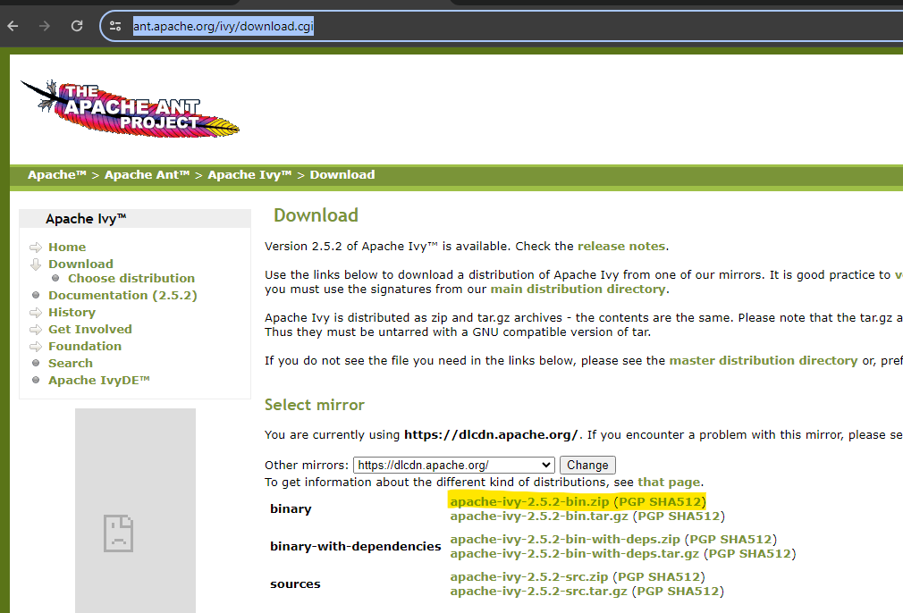
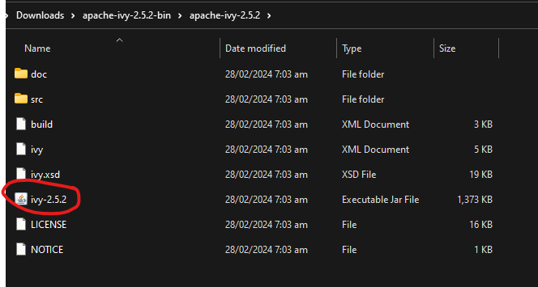
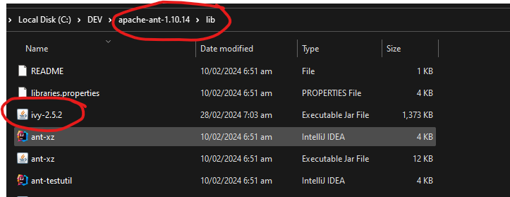
Installation
Prerequisite: Install Apache ANT
Download binary zip file from https://ant.apache.org/ivy/download.cgi
Unzip the file and locate ivy-x.x.x.jar where x.x.x is the version of the jar file
Copy the jar file to the lib folder of the Apache ANT installation

Slide 3
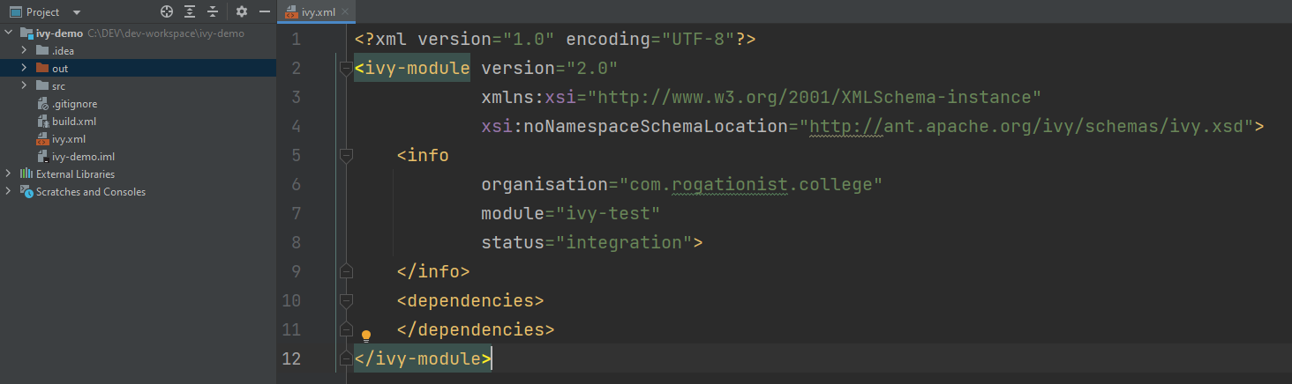
Adding ivy.xml to project
Select the project > New > File then put ivy.xml as filename. This creates an ivy.xml file in the root directory of the project.
In the ivy.xml create an ivy-module tag with info and dependencies tags as shown in the image.
Customize the entries such as organization, module and dependencies in the xml file

Slide 4
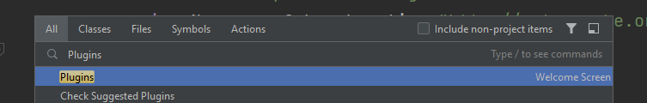
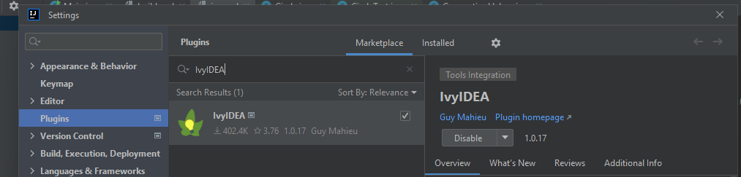
IDE Integration and Setup
Using IntelliJ, download the IvyIDEA plugin.
Go to Search by double pressing Shift key then search for Plugins then select Plugins
In the Plugins, type IvyIDEA then in the Search Results, click the Install button across the IvyIDEA
Click on Apply then OK to close the Settings window

Slide 5
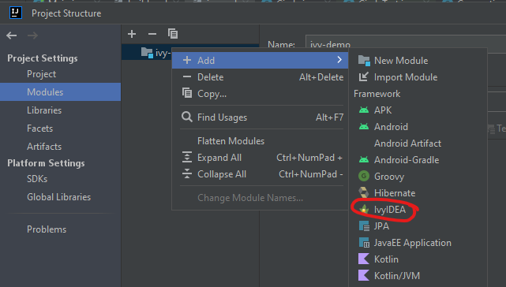
IDE Integration and Setup
To add Ivy as module, go to File > Project Structure
Under Project Settings, select Modules.
Select the project then right click. Select Add then IvyIDEA.

Slide 6
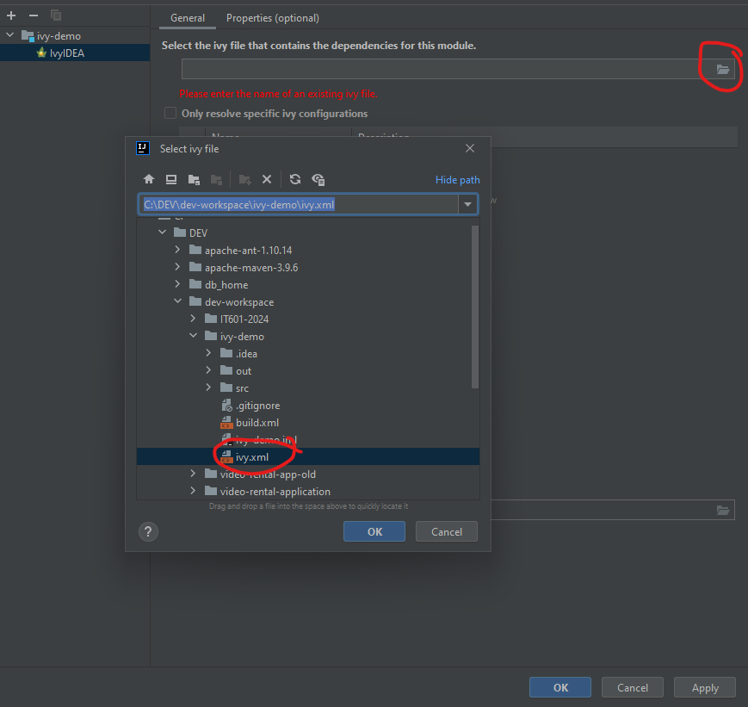
IDE Integration and Setup
In the General Tab, under “Select the ivy…” locate the xml file of the project

Slide 7
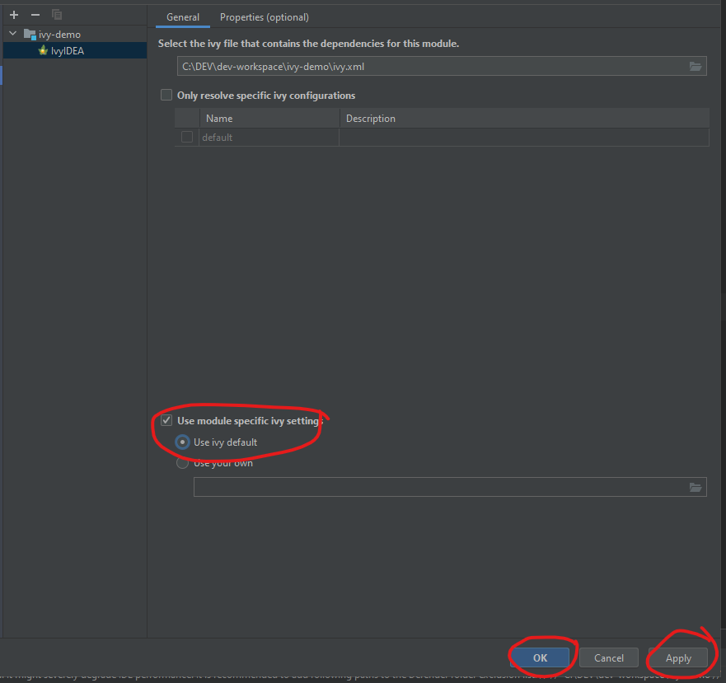
IDE Integration and Setup
Check the “Use module specific ivy setting” the select “Use ivy default”
Click Apply
Click Ok
IntelliJ may prompt to restart so go ahead and wait for the IDE to be reloaded.

Slide 8
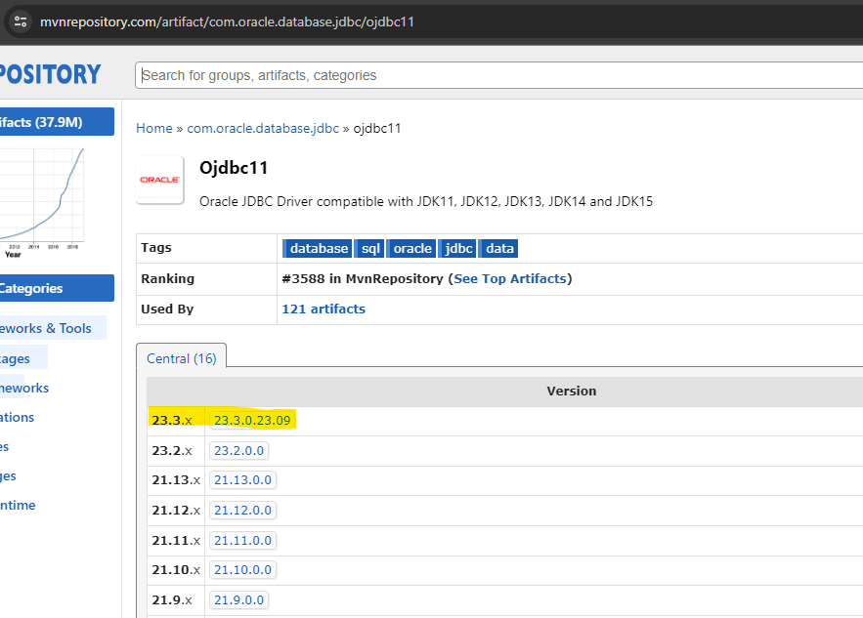
Sample dependency resolution
Suppose a connection to an Oracle database is required by a java application, ojdbc.jar shall be part of the dependencies of the app. To do this:
Google ojdbc 11 jar and look for the search result from maven repository site.
Select the appropriate version and navigate to the maven repo site where the jar is located.

Slide 9
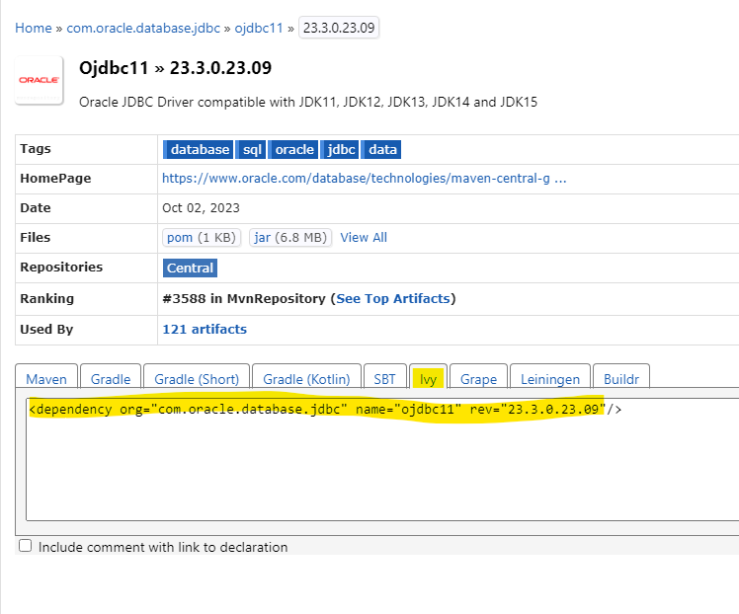
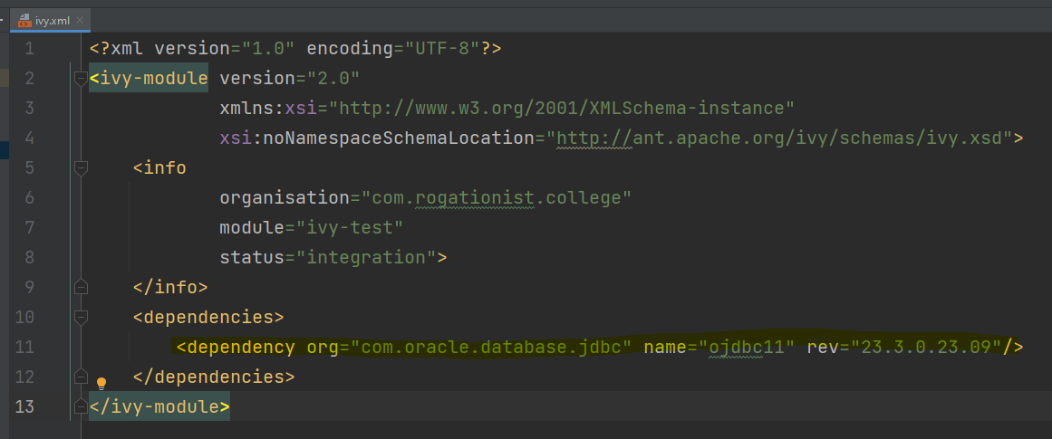
Sample dependency resolution
In the list of dependencies below, select Ivy tab then copy the dependency
Paste the copied dependency at dependencies tags in the ivy.xml then save

Slide 10
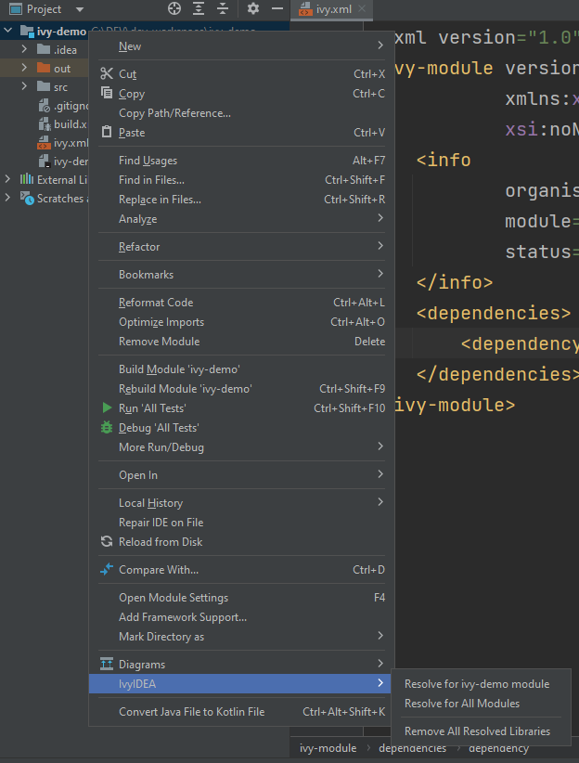
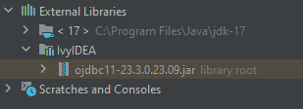
Sample dependency resolution
To update dependencies, right click on project > IvyIDEA > Resolve for <project-name> module
The added dependency should now appear in External Libraries under IvyIDEA
If dependencies did not appear, try Reload from Disk.

